Slide 1
fog (Atmospheric Effect)
Final Project Cisc 400
Presenting
By
Roland Cheremeh

Slide 2
What is fog (Atmospheric Effect) ?
The term fog in 3D graphics is used to describe the effect that makes a distant object seem hazy. It defines the object in any medium, this is because objects underwater can also have a fog effect applied to it.

Slide 3
Objectives for choosing fog (Atmospheric Effect)
To describe and make object seem hazy.
To Understand how object in medium, can also have fog effect applied.
Linear computation is easy and used for the implementation.
To construct a sample program fog that realizes fog effect.
To describe how distance object seem hazy.

Slide 4
Benefit of this project
To build knowledge on the implementation of fog in 3Dgraphics.
Linear fog are easy to calculate and understandable.
Adjusting the density of the fog with up/down arrow keys, help modify the object.
The density of the fog between the point change linearly.
Distance object seems to appear and disappear in the hazy in fog effect.

Slide 5
Key ideas of the Fog
Calculation of the fog factor.
Position of the eye point.
Color of the fog.
Distance of the fog( Starting point and end point).
Passing the fog color, distances, and eye point to uniform variable
Setting clear color and enable hidden surface removal
Increasing and decreasing maximum distance of the fog with up and down arrows respectively.

Slide 6
How to implement fog
There are several ways to calculate fog, But I choose to use linear computation, this because it makes the calculation of linear fog very easy. This method will determine the density of the fog by setting the starting, thus the distance where the cube or object start to become hazy, and the end point at which the cube or object becomes a complete obscured. The fog density between the point will be changed linearly.

Slide 7
Equation of fog factor
Fog factor= (end point)-(distance from eye point)/( (end point)-(starting point))
Where
(starting point) less than or equal to (distance from the eye point) and less than or equal to (eye point).

Slide 8

Equation of the color of the fog
The object vanishes as the fog factor decrease, then the surrounding color will be mix with the color of the fog. Also, as the fog factor increases the object color get mixed within the hazy.
Formular is:
color=mix(originalcolor, fogColor, fogfactor)

Slide 9
How the vertex and fragment shaders are linked together to form the cube
The vertex shader of the cube transforms the vertices, modify it position and normal vector, then assigning the final position to the gl_position in addition with varying to be used in fragment shader.
After rasterization, the fragment shader, it takes the attribute of the fragment which is computed by the vertex shader to compute and give color to the displayed color of the object.
In this cube only three faces are shown, so the fragment shaders of the three different colors for all the three cube faces are modified in the vertex data shown below figure 1.1

Slide 10
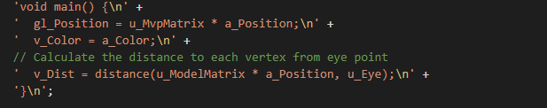
Postion and distance of the cube figure 1.1
The vertex data position and distance of the cube.

Slide 11
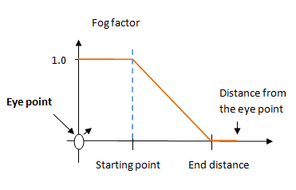
POSITION OF THE EYE POINT
How the eye point will be used to calculate the effect of the fog, using linear fog.

Slide 12
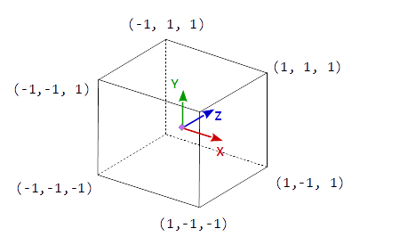
Position of the cube
The cube result of gl_Position.xyz / gl_Position.w has to be in the range (-1,-1,-1) to (1,1,1), the object space. This means each component (x, y and z) of the result, <= 1.0 and has to be >= -1.0 and in the fog.

Slide 13
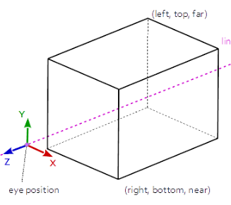
How the cube is viewed lineraly
The cube is viewed at the eye position by the line of sight-z.

Slide 14
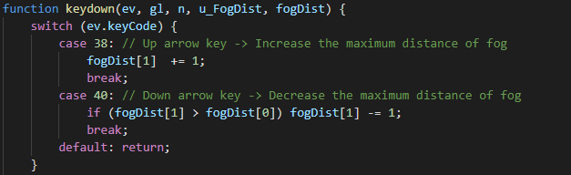
Keyboard controls of the fog
In switch case, the event(ev) will trigger an action, if the user press on the key-code.
At case 38 (Up arrow key), increases the distance of the fog
with increment of plus 1 to fogDist, hence, the fog will show.
At case 38 (Down arrow key), decreases the distance of the fog
with decrement of minus 1 from fogDist, hence, the fog will vanish from the hazy.

Slide 15
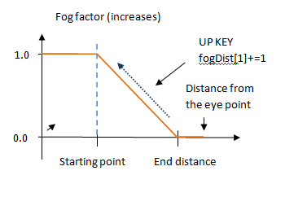
Up key Function
As the up key is pressed it, the cube vertices and color begins to appear because, at first the object is at 0.0 in x-axis, the vertices and color appear when the object moves up until it get to the 1.0 which make it complete with an increment of plus one. When up key is released at any position it stop. It usally start from the endpoint to the starting point.

Slide 16
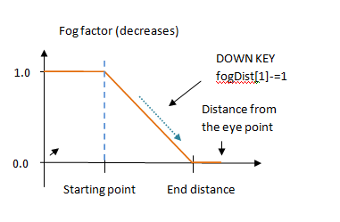
Down key Function
As the down key is pressed it, the cube vertices and color begins to disappear because, the object is at 1.0 in y-axis, the vertices and color disappear when the object moves down until it get to the 0.0 which make it completely vanish from the hazy with an decrement of minus one. When down key is released at any position it stop. It usually start from the starting point to the ending point.

Slide 17
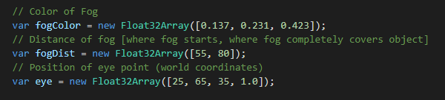
Variable to store , color, distance and eye point of the fog
The fog Color variable stores the color of the cube as specific face.
The fog Dist variable stores the distance between the vertices of the cube .
The eye variable stores the eye point of the cube as specific face when viewed at each position of the cube.
These are all key ideas of fog algorithm.

Slide 18
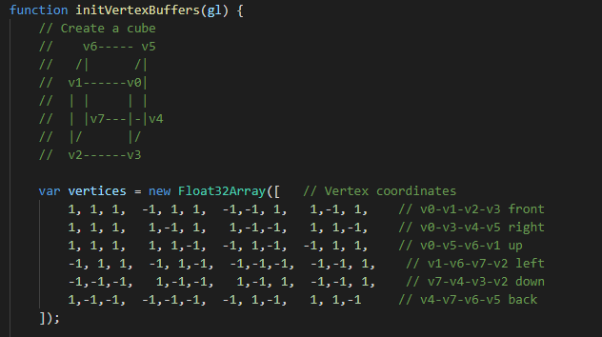
Vertex coordination to create a cube
The formular is: Faces + Vertices - Edges = 2 . Now,
From the formular there are 24 vertices (4 per side): This is because each face of the cube requires four vertices to define it, and each vertex is linked by three faces. So by passing in little data inside by creating an array of all 24 vertices, then linking it to each vertex by its index into that array instead in a form of 32-bit floating numbers in byte.

Slide 19
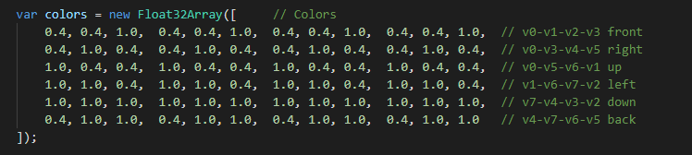
Color of the cube
After the vertices has been form , each corner of the cube assign a single vertex needs to have a single specific color and three different faces of colors; In order to create three copies of each vertex in three different colors and multiple vertices with the same vertex coordinates, one for each face. Also in a form of 32-bit floating numbers in byte.

Slide 20
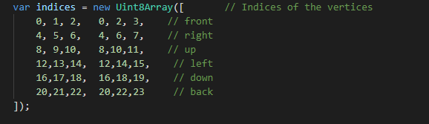
Indices of the Vertices of the cube
The sequence of vertex indices values, points to a different set of vertices for each face and does not link a vertex with front surface and other face. Also it defines a face of a cube as two triangles using the indices into vertex array and specify each triangle positions. This is basically not the key idea of fog algorithm.

Slide 21

Frame buffer for the hidden surface of the cube
The cube vertices, the hidden colors of the cube to match the color of the hazy. These vertices are the three vertices of the a_position vertices and the a_color colors which are initilized by initArrayBuffer() method. The color and position is specified by the codes below.

Slide 22
Drawing the cube
The face of the cube is comprised of two triangles. I will take one square plane into three dimension with the addition of five more faces to create the cube. I switch the drawing using vertices by directing it to gl.drawArray method. This is done by using vertex array as a table and reference each individual vertex in the table by calling the gl.drawElement method.

Slide 23
Thank You

